Slide 1


Slide 2
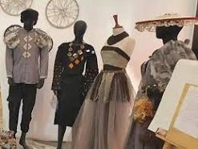
Illustration of fashion
https://mite.edu.pk/faculty-of-arts-and-design/

Slide 3
Types of fashion designing. Clothing life style

Slide 4

Fashion designing
Fashion designer create clothing and accessories
Fashion and clothing also indicate the status of the people.
A girl’s fashion includes a lot of trendy thing.
Fashion includes the dressing style, in which we live, what we eat, and our hobbies.

Slide 5
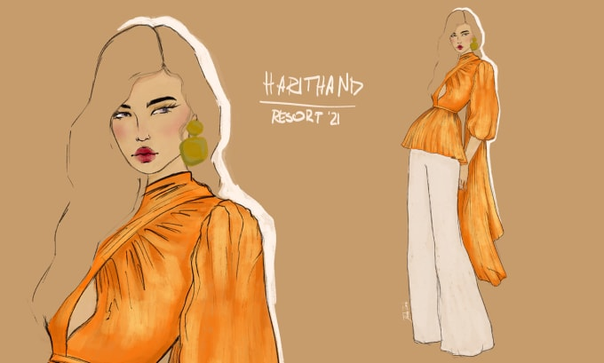
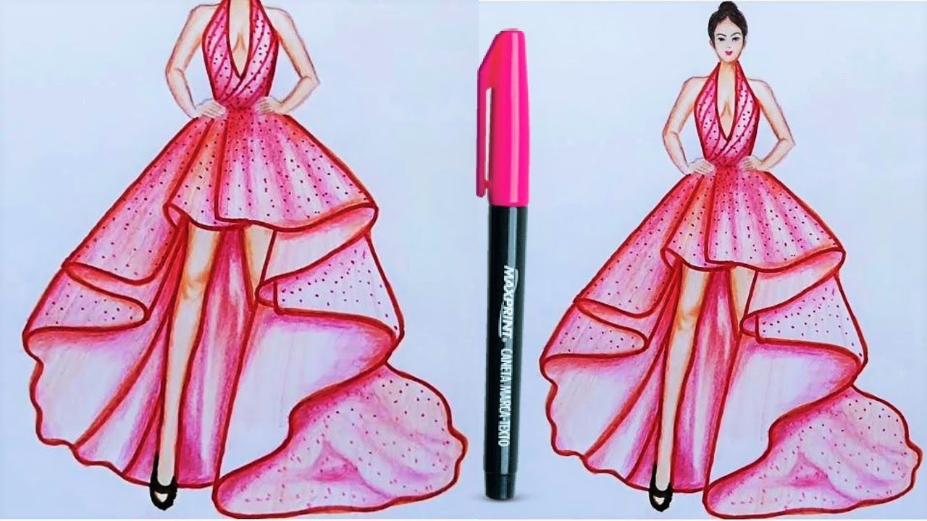
Aesthetics of fashion

